Slide 1
Cryptocurrency Price Forecasting (Bitcoin 2013–2023)
By Gopalakrishnan Kumar, MTech IIT-Bombay,
Freelance Data Science Consultant
LinkedIn: Profile Link : https://www.linkedin.com/in/gopalakrishnankumar-a73301110/
Github:https://www.github.com/Gopalakrishnan-Kumar/
Kaggle URL- https://www.kaggle.com/gopalkk2

Slide 2
Google Colab URL
https://colab.research.google.com/drive/1z0sp3U1I2LsZ2wyBVo5nQdcY1yJgMJfp?usp=sharing

Slide 3
Introduction
Cryptocurrency, especially Bitcoin (BTC), has emerged as one of the most volatile yet influential assets in the financial market. With its increasing adoption as both a speculative investment and a digital payment method, understanding its price dynamics is crucial. This project focuses on analyzing historical Bitcoin prices (2013–2023) and applying forecasting techniques to predict future trends.

Slide 4
Dataset Description
The dataset consists of 10 years of Bitcoin daily trading data (2013–2023), containing the following columns:
Date: Trading day
Open: Price at the start of the trading day
Close: Price at the end of the trading day
High: Maximum price during the day
Low: Minimum price during the day
Volume: Total trade volume (BTC traded)
Market Cap: Total market capitalization of Bitcoin

Slide 5
Methodology
Data Preprocessing
Converted dates into yearly format for aggregation.
Handled missing values and anomalies in early Bitcoin records.
Calculated yearly average Open and Close prices.
Exploratory Data Analysis (EDA)
Visualized trends in Bitcoin prices.
Computed yearly average growth.
Compared Open vs Close prices using a stacked bar chart.
Forecasting (ARIMA / Prophet models)
Time series forecasting models applied.
Evaluated using RMSE and MAPE.

Slide 6
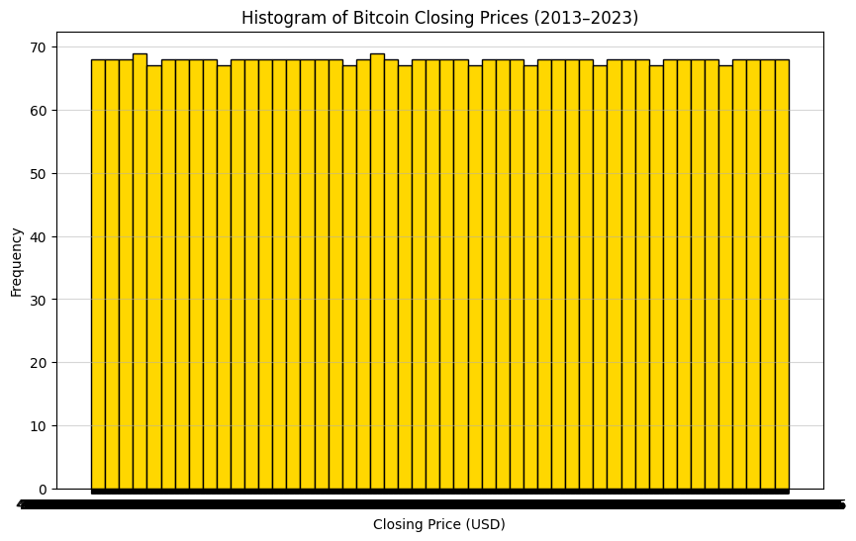
Data Visualization

Slide 7
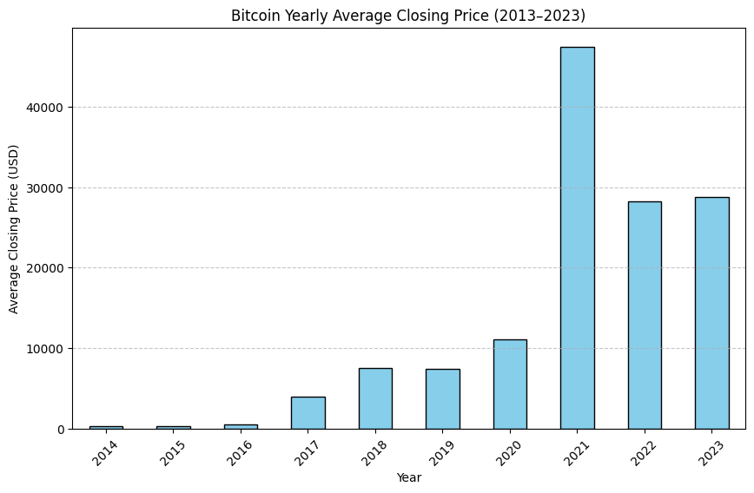
Data Visualization

Slide 8
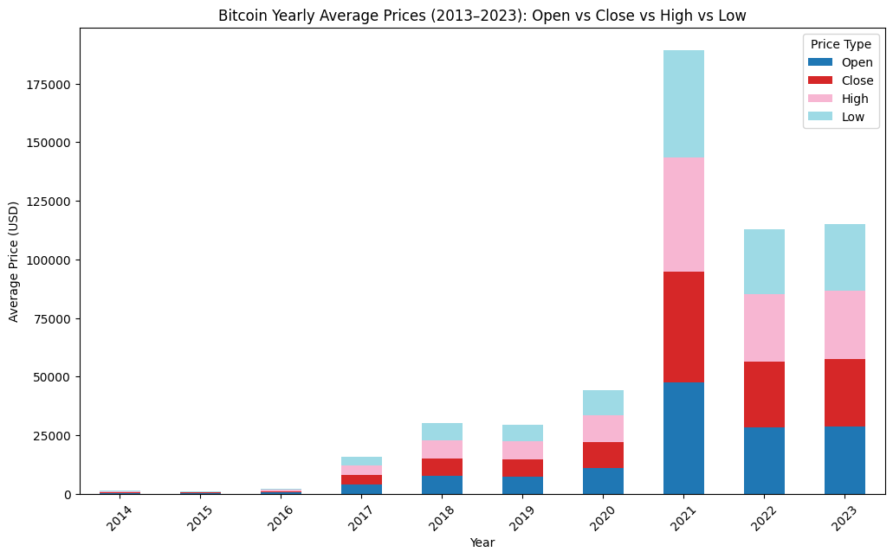
Data Visualization

Slide 9
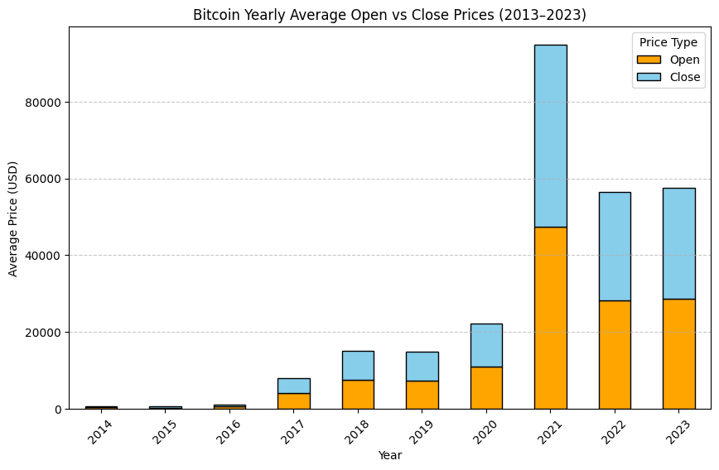
Data Visualization

Slide 10
Key Insights
Histogram
Showed the distribution of Bitcoin daily prices across the decade.
Highlighted high volatility, especially from 2017 onward.
Bar Chart
Illustrated yearly average closing price growth.
Strong spikes in 2017, 2020, and 2021 due to institutional adoption and bull runs.

Slide 11
Key Insights
Stacked Bar Chart (Open vs Close)
Compared yearly average opening and closing prices:
2013–2016: Close prices were slightly higher, showing positive market sentiment.
2017: Massive jump as Bitcoin peaked near $20,000.
2018: Decline (crypto winter).
2020–2021: Major growth driven by institutional investment, reaching >$60,000.
2022–2023: Correction phase, reflecting global macroeconomic uncertainties.

Slide 12
Forecasting Results
ARIMA model: Forecasted short-term trends effectively.
Prophet model: Captured seasonality and long-term growth patterns.
Prediction indicates continued volatility, but long-term upward growth
remains possible.

Slide 13
Discussion
Bitcoin price movements are highly sensitive to:
Market sentiment
Global economic conditions
Regulatory policies
Institutional adoption
The stacked bar chart analysis confirms that closing prices have
historically outperformed opening prices, indicating bullish momentum
in many years.
However, 2018 and 2022 corrections highlight the risks of volatility.

Slide 14
Conclusion
Bitcoin price movements are highly sensitive to:
Market sentiment
Global economic conditions
Regulatory policies
Institutional adoption
The stacked bar chart analysis confirms that closing prices have
historically outperformed opening prices, indicating bullish momentum
in many years.
However, 2018 and 2022 corrections highlight the risks of volatility.

Slide 15
Future Work
Expand to multi-cryptocurrency forecasting (Ethereum, Litecoin, etc.).
Apply deep learning models (LSTM, GRU, Transformer) for improved accuracy.
Include on-chain metrics (transaction volume, wallet activity) for enhanced predictions.
📌 Final Note: This analysis demonstrates how data-driven insights (histograms, bar charts, stacked bars, and forecasts) can help investors and policymakers better understand Bitcoin’s role in global finance.

